Slide 1
Time Series Forecasting
Lecture 8
David Nagy, Mohan Sukumar

Slide 2
Learning Objectives
Recap - Time Series Analysis
Time Series Forecasting
Standard Forecasting models
AR, MA, ARIMA
ETS

Slide 3
Time Series Analysis Techniques

Slide 4
Differencing

Slide 5
Differencing
A technique used in time series analysis to remove the dependence of the observations on time.
Help stabilize the mean of the time series by removing the trend.
Help remove the seasonal component.
After differencing, the resulting time series is said to be stationary.

Slide 6
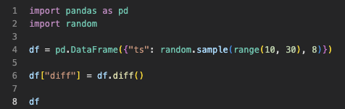
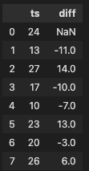
Differencing
The first-order difference - is the difference between the current observation and the previous observation.
The second-order difference - is the difference between the first-order difference and the previous first-order difference, and so on..
diff() method in pandas to perform differencing.
( the default value of periods=1 is used to compute the difference between consecutive values)

Slide 7
Detrend and Deseasonalize

Slide 8
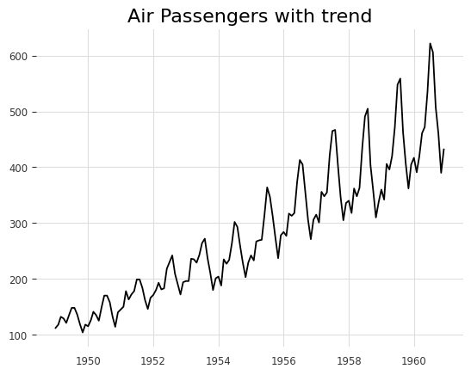
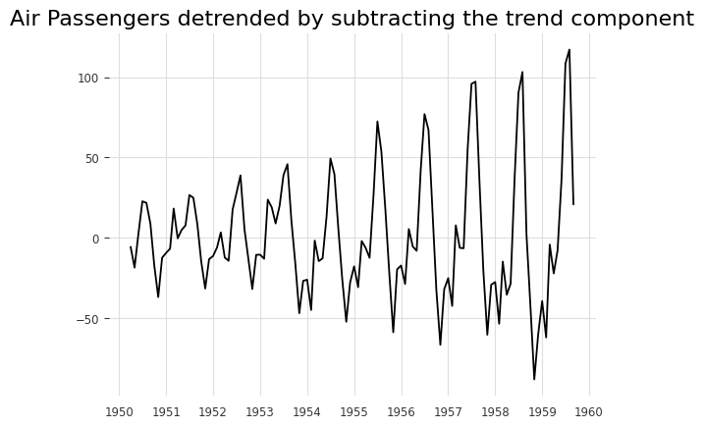
Detrending
It means to remove the trend component from the time series

Slide 9
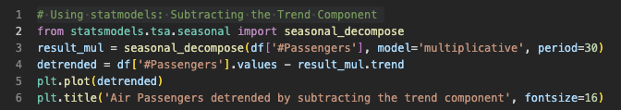
Detrending
It means to remove the trend component from the time series

Slide 10
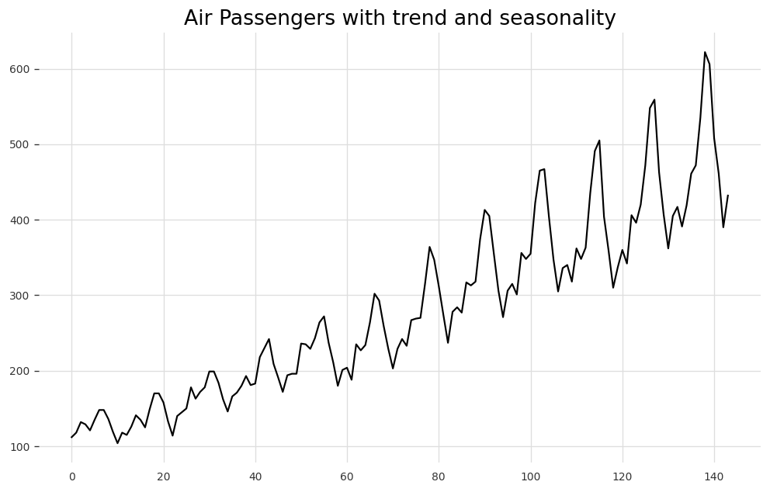
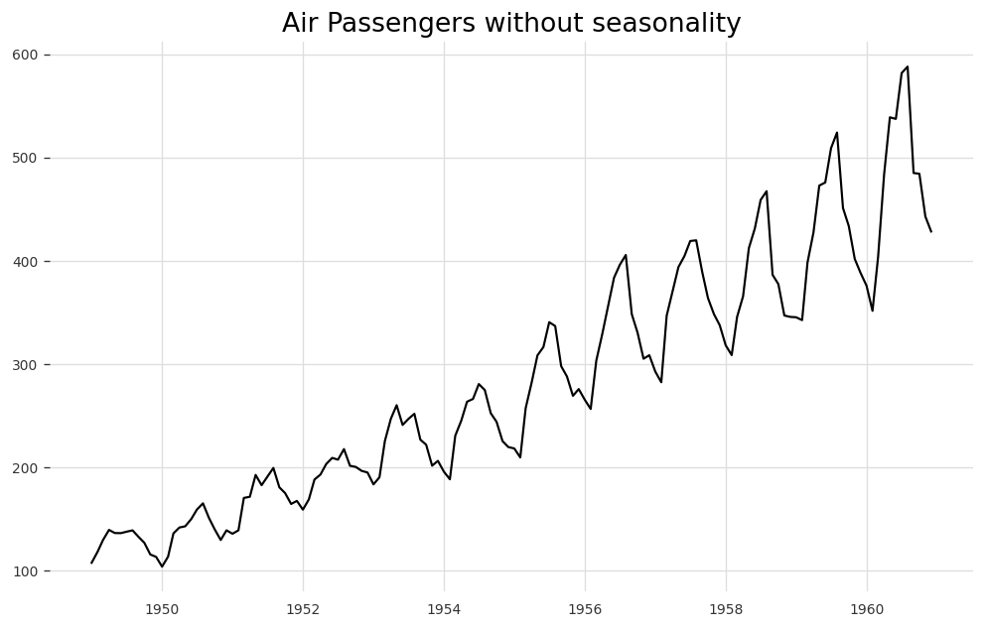
Detrending
It means to remove the seasonal component from the time series

Slide 11
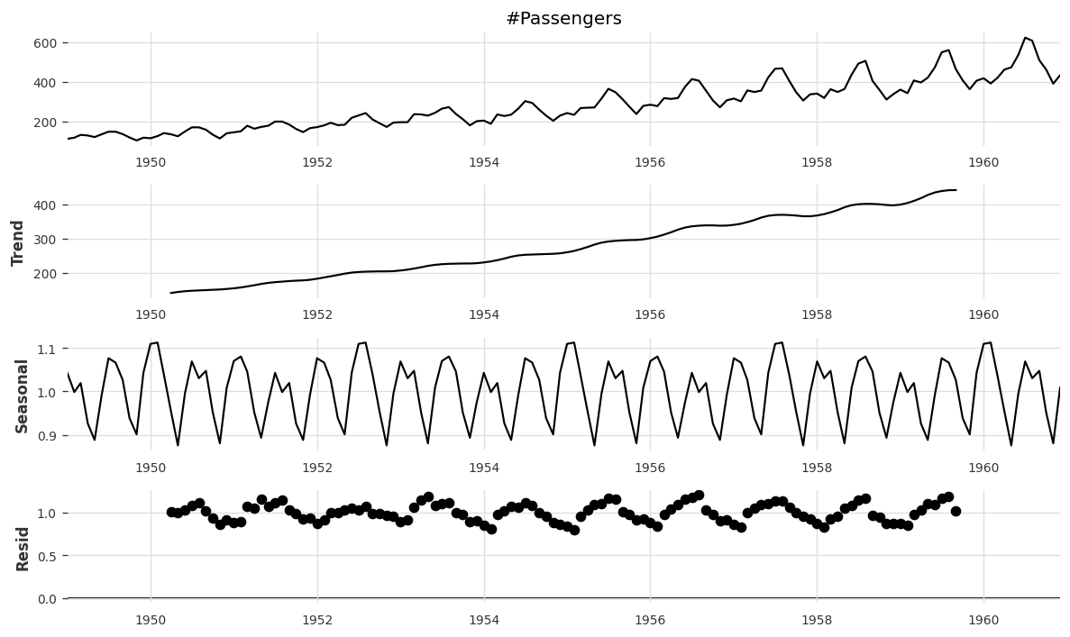
Complete decomposition

Slide 12
Autocorrelation

Slide 13
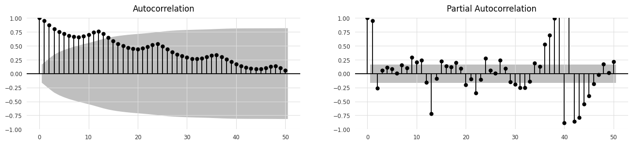
Autocorrelation and Partial Autocorrelation

Slide 14

Break

Slide 15
Time Series Forecasting

Slide 16
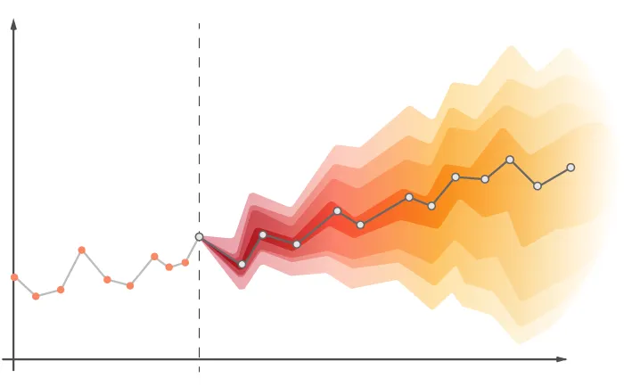
What is forecasting
Future predictions based on the time series data analysis.
Understand the time series characteristics like trend, seasonality etc
Identify the best method to make the time series stationary
Reverse transformation of data is possible

Slide 17

Training and testing
training set—a subset to train a model.
test set—a subset to test the trained model.
Make sure that your test set meets the following two conditions:
Is large enough to yield statistically meaningful results.
Is representative of the data set as a whole. In other words, don't pick a test set with different characteristics than the training set

Slide 18
Standard Forecasting Models

Slide 19
Auto Regression

Slide 20
AR - Auto Regression
Uses past values(lags) of the forecast variable to predict future values.
y_{t} = c + Σ( φ_{i} * y_{t-i} ) + ε_{t}
where:
y_{t} is the value of the variable at time t
c is a constant term
φ_{i} is a numeric constant by which we multiply the lagged variable y_{t-i}
ε_{t} is the error term at time t

Slide 21
Moving Average

Slide 22
MA - Moving Average
Help smooth out short-term fluctuations and highlight longer-term trends
Simple Moving Average (SMA) - average of a fixed number of data points over a specified time period.
Weighted Moving Average (WMA) - Assigns a weight to each data point based on its position in the time period. Help reduce the influence of older data points.
Exponential Moving Average (EMA) - Assigns exponentially decreasing weights to the data points.
Recent data points have a higher weight than older ones, but all data points contribute to the calculation.

Slide 23
ARIMA

Slide 24
ARIMA - the order
Represented by three parameters: p, d, and q.
p - number of autoregressive (AR) terms
d - number of differences (d)
q - number of moving average (MA) terms
ARIMA(1,1,1) model : y_{t} - y_{t-1} = c + φ₁*(y_{t-1} - y_{t-2}) + θ₁*(e_{t-1})
Where:
y_{t} is the value of the time series at time t
y_{t-1} is the value of the time series at time t-1
e_{t-1} is the error term at time t-1
φ₁ and θ₁ are the autoregressive and moving average coefficients respectively

Slide 25
Representation of ARIMA of order (p,d,q) in python
from statsmodels.tsa.arima.model import ARIMA
model = ARIMA(y, order=(2,1,2))
result = model.fit()
print(result.params)
# "params" is a vector or array that contains the estimated values of the AR, MA, and differencing parameters of an ARIMA model, which can be used to make forecasts of future values.

Slide 26
Arima model limitations
Real-world time series exhibit nonlinear patterns and dependencies that cannot be captured by linear models.
Stationarity assumption.
Memory-based models that only use a finite number of past values of the time series to make predictions

Slide 27
ARIMA
Combines the advantages of Autoregressive (AR), Moving Average (MA), and differencing techniques(I).
Confirm the stationarity with ADF test.
By examining the ACF and PACF plots, identify the order of the AR and MA components, as well as the level of differencing required to make the time series stationary.
Fit the Model.
Validate the Model.
Forecast values.
Evaluate the Model.

Slide 28
SARIMA

Slide 29
SARIMA
Includes the seasonal component.
Notation for a SARIMA model is (p, d, q)(P, D, Q)s
where:
p: the order of the autoregressive (AR) term
d: the order of differencing required to make the time series stationary
q: the order of the moving average (MA) term
P: the order of the seasonal autoregressive (SAR) term
D: the order of seasonal differencing required to make the time series stationary
Q: the order of the seasonal moving average (SMA) term
s: the length of the seasonal cycle (e.g., 12 for monthly data with annual seasonality)

Slide 30
SARIMA Model approach
To fit a SARIMA model, the same approach as ARIMA can be used.
Values of p, d, and q are selected based on the ACF and PACF plots
Values of P, D, Q, and s are selected based on the seasonal ACF and PACF plots.
The residuals are checked for stationarity and autocorrelation.

Slide 31

WE DID IT!

